Slide 1
Work Update Hydrogen Deployment and Fleet Optimization
Week of 7/3

Slide 2
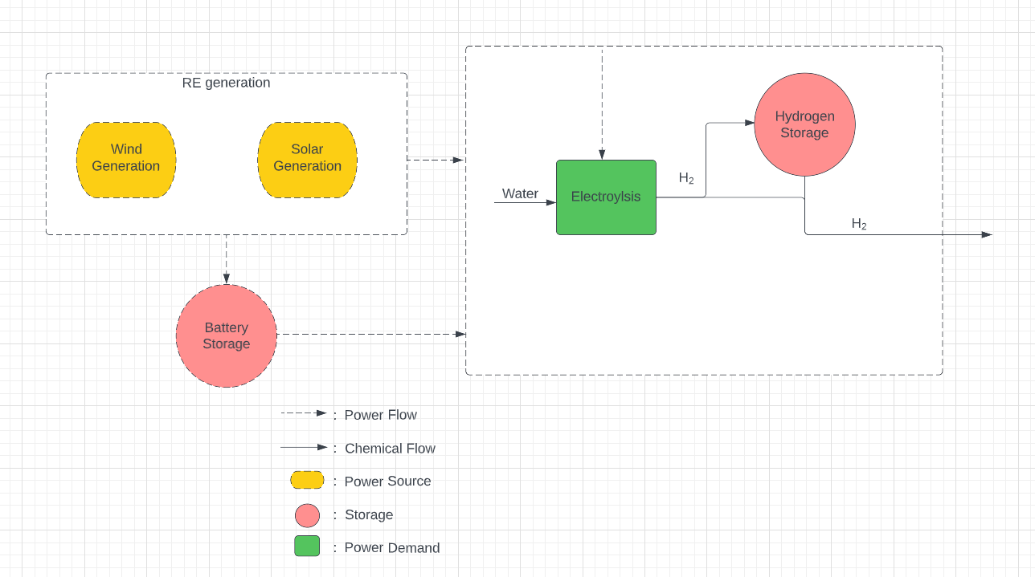
Created Hydrogen Model to compare with ammonia side

Slide 3
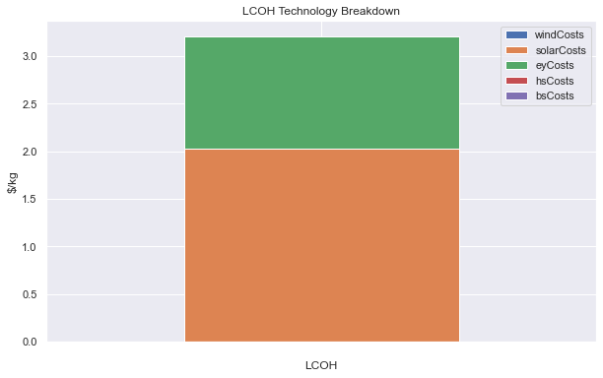
LCOH Output of Production Model Schematic

Slide 4

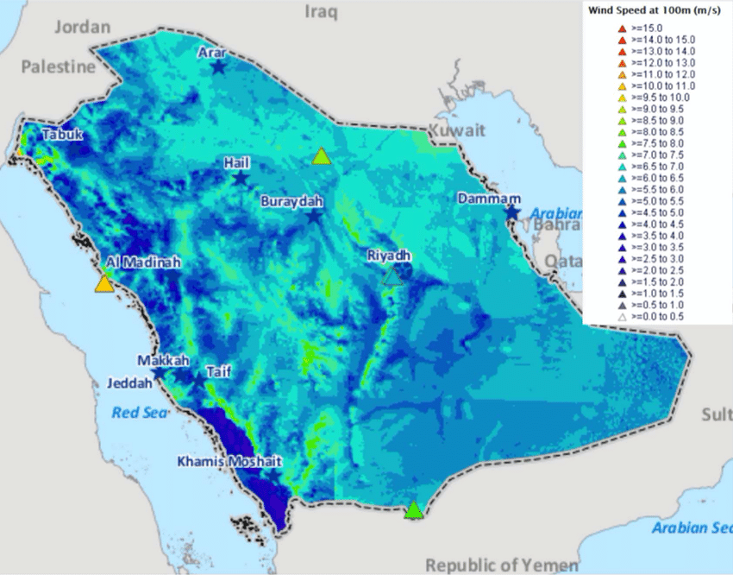
Renewable Energy data profiles
Wind strong in Northwest and Northeast
Solar strong in Northwest
From Solar GIS
From Saudi Renewable Energy Atlas

Slide 5
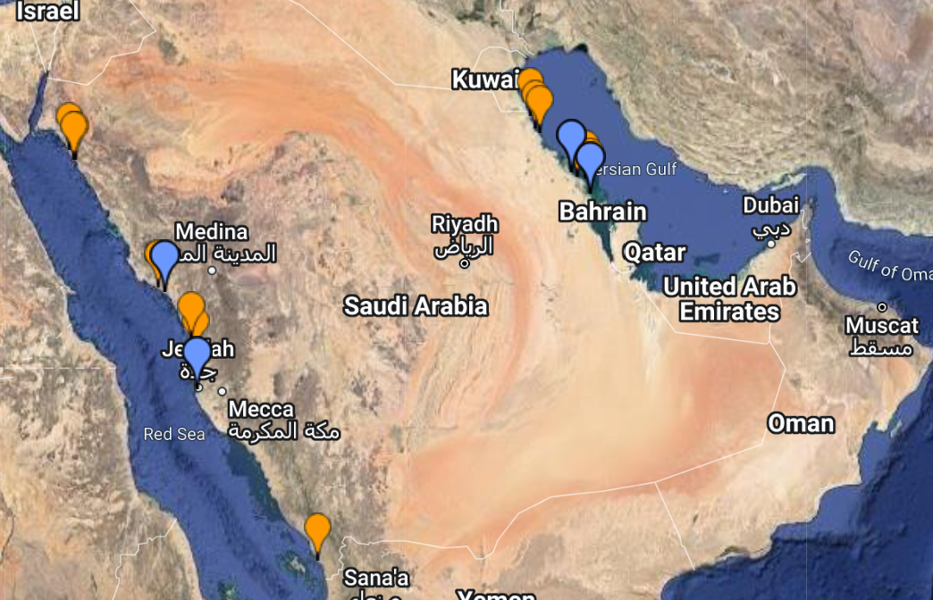
Overlapping RE data with port locations and water access, I envision three sites to base case study on and use renewable profiles
Northwest
Northeast
Central West
From: http://www.worldportsource.com/ports/SAU.php

Slide 6
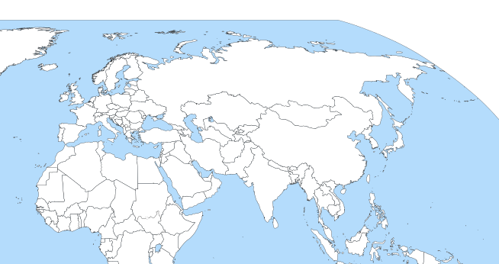
Network Model difficulties: runtime

Slide 7
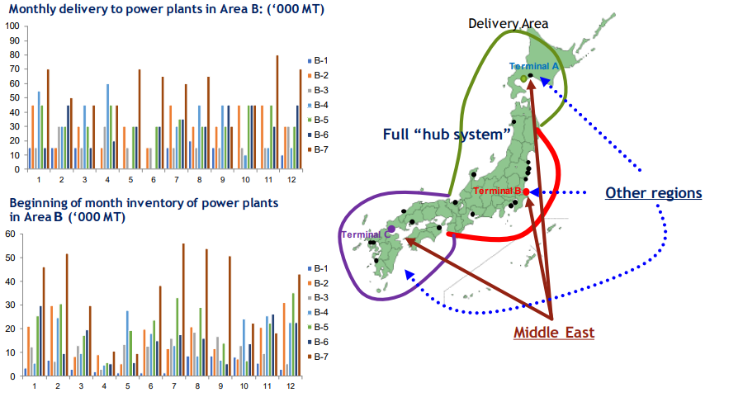
Converting ship modeling from network microscopic to general mesocopic analysis
From: Kawakami, Y., S. Endo, and H. Hirai. "A feasibility study on the supply chain of CO2-free ammonia with CCS and EOR." (2019).

Slide 8
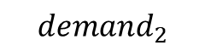
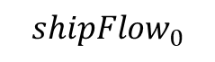
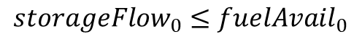
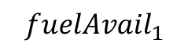
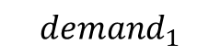
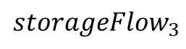
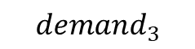
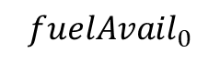
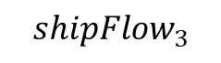
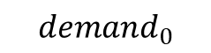
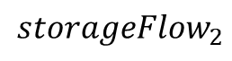
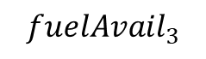
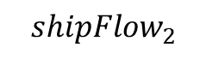
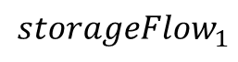
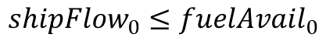
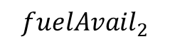
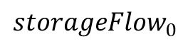
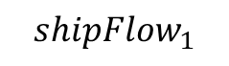
Structure of model operations
$${storageFlow}_{0}$$
$${storageFlow}_{1}$$
$${storageFlow}_{2}$$
$${storageFlow}_{3}$$
$${shipFlow}_{0}$$
$${shipFlow}_{1}$$
$${shipFlow}_{2}$$
$${shipFlow}_{3}$$
$${fuelAvail}_{0}$$
$${fuelAvail}_{1}$$
$${fuelAvail}_{2}$$
$${fuelAvail}_{3}$$
$${demand}_{0}$$
$${demand}_{1}$$
$${demand}_{2}$$
$${demand}_{3}$$
This structure simplifies the overall picture and doesn’t allow for ship inflow and consumption in the same month
$${storageFlow}_{0}≤{fuelAvail}_{0}$$
$${shipFlow}_{0}≤{fuelAvail}_{0}$$

Slide 9
Hypothetical run through of model
Region 1: KSA
Sole exporter
Region 2: Japan
Early importer
Region 3: Germany
Mid importer
Region 4: South Korea
Late importer

Slide 10
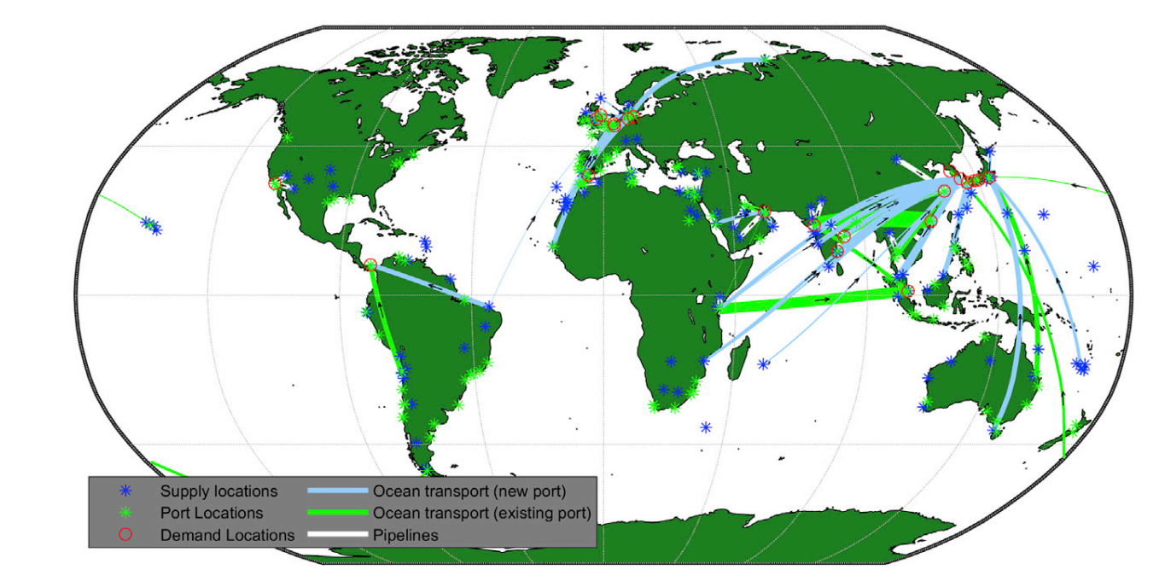
Model output vision: dynamic representation of ammonia flows around the world in conjunction with dynamic production
Visualize the output of green ammonia flows from production in KSA
Resolution can go down to daily or even hourly for ammonia flows
Can decrease # of ports for model runtime
From: Salmon, Nicholas, René Bañares-Alcántara, and Richard Nayak-Luke. "Optimization of green ammonia distribution systems for intercontinental energy transport." Iscience 24.8 (2021): 102903.

Slide 11
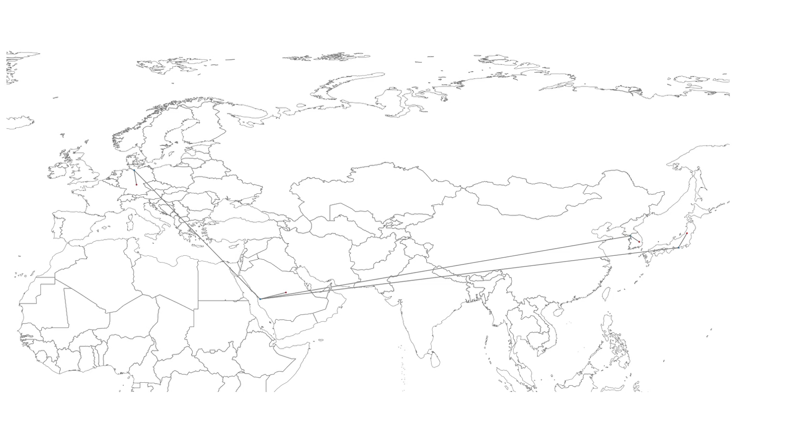
Initial model output results visualization

Slide 12
Next Steps
Gather real world data for transportation model
Length of routes
Ship models and configurations for hydrogen and ammonia
Port costs for hydrogen and ammonia
Run initial hydrogen real world data tests with satellite data from specific sites
And ammonia after reaching out to Mani on Electroyzer costs
Create final cacking outline for ammonia
Use Grid
Use Ammonia fuel-?run through fuel cell for electricity generation?
Use Natural Gas

